Slide 1

Vending Machine With VHDL
    Rajesh Kurpad
    Jonathan Bittner
    James Michelich
    Keeram Lee

Slide 2
Project Goals
Design and digitally construct a fully operational vending machine
  Vending machine should be flexible enough to allow for multiple programming modes
  Vending machine needs to be reliable and user-friendly
Minimize logic and states such that the design can be realized in VHDL and synthesized inexpensively onto a Xilinx chip

Slide 3
Approach
Use the Teer Vending machine we all know and love as a model for the behavior of our Vending Machine
  8 rows, 8 columns (A-H, 0-7) for selection, with the ability to cancel a selection, price is determined by the row
  Accepts nickels, dimes, quarters, and dollars, with the ability to cancel
  Exact change required indicator, not enough funds indicator, item output, change output based on a greedy algorithm
Modular component based design is optimal
  Organize vending machine into components with specific tasks
  Each component will have its own set of states and SM chart to determine its own behavior
  A central unit will comprise be responsible for relaying and communicating signals with each individual component
Active Edge of Clock – synchronized on the active edge of the clock

Slide 4
Vending Machine Package
Defines coin, row, col, and item types
    type coin is (NO_COIN, nickle, dime, quarter, dollar);
    type row is (NO_SELECTION, A, B, C, D, E, F, G, H);
    type col is (NO_SELECTION, C0, C1, C2, C3, C4, C5, C6, C7);
    type item is (NO_ITEM, A0, A1, A2, A3, A4, A5, A6, A7
    B0, B1, B2, B3, B4, B5, B6, B7,
    C0, C1, C2, C3, C4, C5, C6, C7,
    D0, D1, D2, D3, D4, D5, D6, D7,
    E0, E1, E2, E3, E4, E5, E6, E7,
    F0, F1, F2, F3, F4, F5, F6, F7,
    G0, G1, G2, G3, G4, G5, G6, G7,
    H0, H1, H2, H3, H4, H5, H6, H7);
Define a set of common Functions
    function get_coin_value(c: in coin) return integer;
    function get_coin(value: in integer) return coin;
    function get_item_selection(r: in row; cl: in col) return item;
    function get_item_price(r: in row) return integer;
    function dispense_coin(change: in integer) return coin;

Slide 5
Vending Machine Design – 4 Major Components
Coin Insertion – monitors coin input including nickels, dimes, quarters, and dollars and communicates coin type and coin value
Item Selection – monitors row selection and column selection
Change Dispenser – outputs the appropriate amount of change
Vending Machine Control – keeps track of the numeric insertion value, price of selected item, and controls the flow of the vending machine from coin insertion to item selection to item dispensed and change dispensed

Slide 6
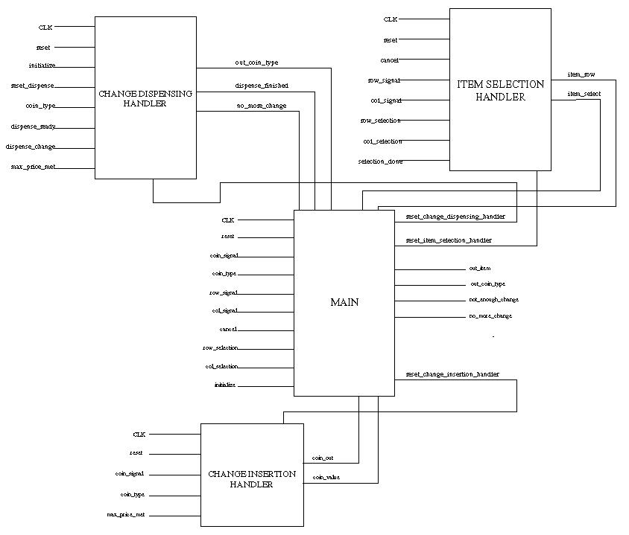
Overview of System

Slide 7

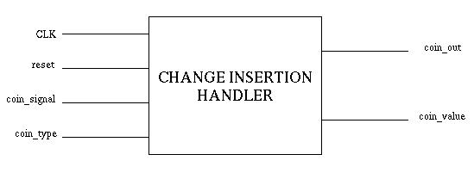
Change Insertion
Inputs
  CLK, reset
  Coin Signal – detect insertion of a coin
  Coin Type – detect type of coin
Outputs
  Coin Type
  Coin Value

Slide 8
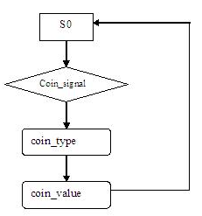
Change Insertion SM Chart

Slide 9
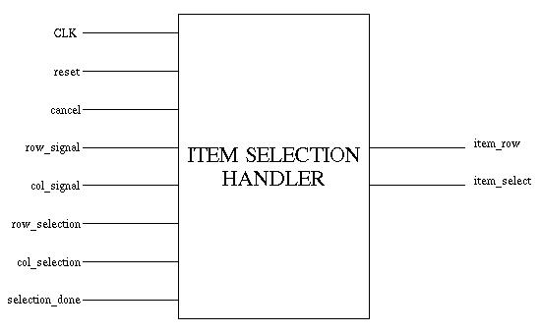
Item Selection
Inputs
  CLK, reset
  Cancel – cancels selection
  row_signal – monitors a row selection
  col_signal – monitors a column selection
  row_selection – given a row_signal, reads in the row selection
  col_selection – given a col_signal, reads in the column selection
  selection_done – signal from main
Outputs
  item_row – determines price of item
  item_select – item selected (ie B5)

Slide 10
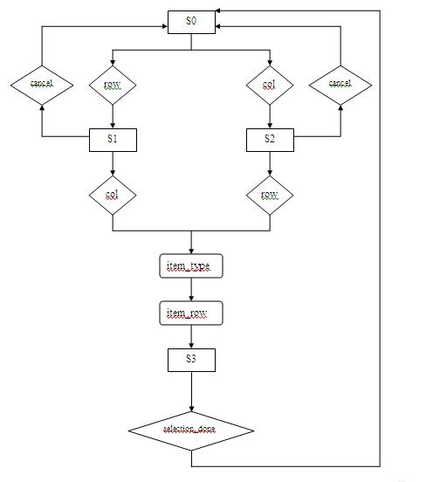
Item Selection SM Chart

Slide 11
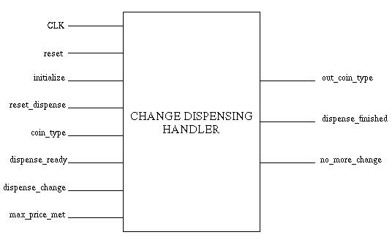
Change Dispenser
Inputs
  CLK, reset
  Initialize – initialize coin registers
  reset_dispenser – communication from main module
  dispense_ready – signal indicating change ready to be dispensed
  dispense_value – singal determining the amount to be dispensed
  max_price_met – signal indicating that the maximum amount of change has been inputted, any further change will be dispensed
Outputs
  out_coin_type – signal indicating the type of coin dispensed
  dispense_finished – signal indicating that the dispense routine is finished
  no_more_change – signal indicating that no more change is left in the machine

Slide 12
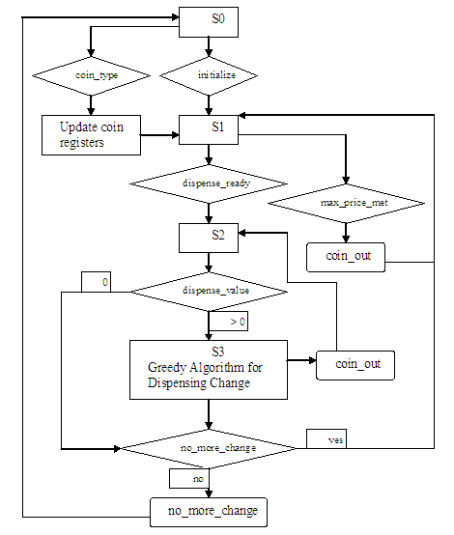
Change Dispenser SM Chart

Slide 13
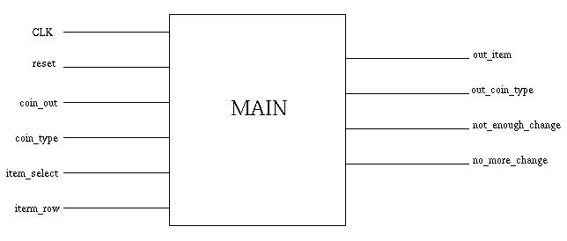
Main Module
Inputs
  CLK, reset
  coin_type (from coin insertion module)
  coin_out (from coin dispenser module)
  item_select
  item_row
Outputs
  Dispensed item
  Dispensed change
  Not enough change indicator
  Exact change indicator

Slide 14
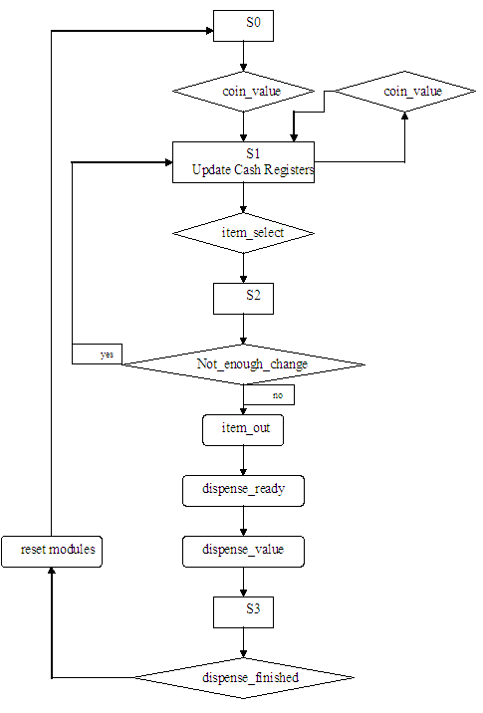
Main Module SM Chart

Slide 15
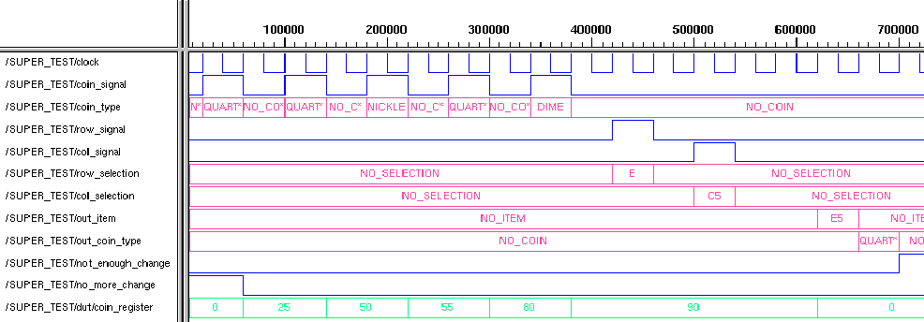
Simulations
Normal Operation with change returned

Slide 16
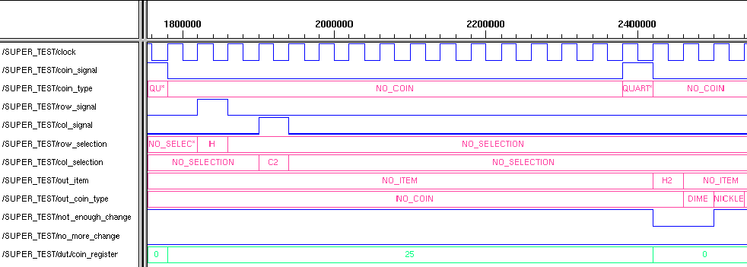
Simulations, Cont.
Insufficient amount of money inputted

Slide 17
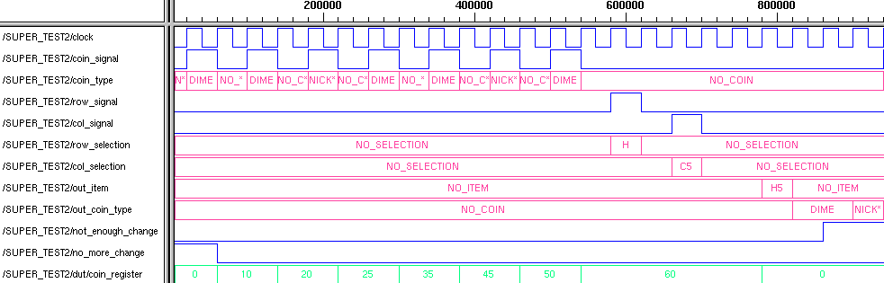
Simulations, Cont.
Output is 2 dimes, 1 nickel instead of a quarter

Slide 18
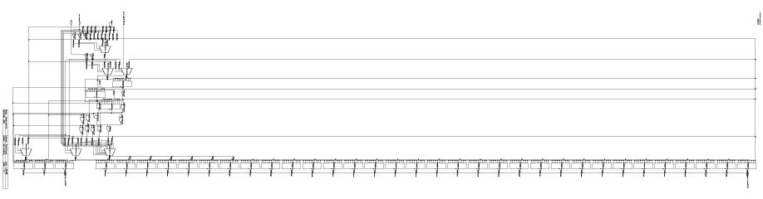
Synthesis - Main

Slide 19
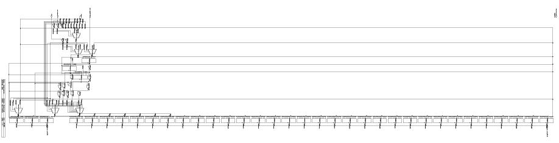
Synthesis – Change Insertion

Slide 20
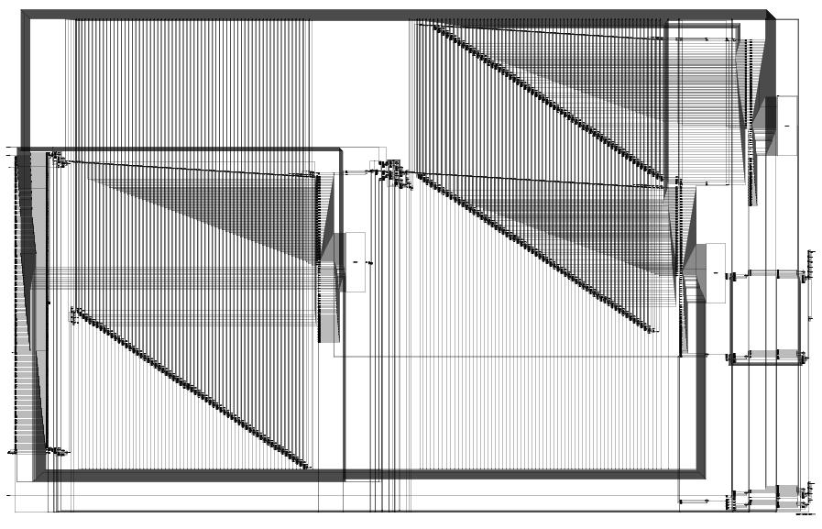
Synthesis – Item Selection

Slide 21
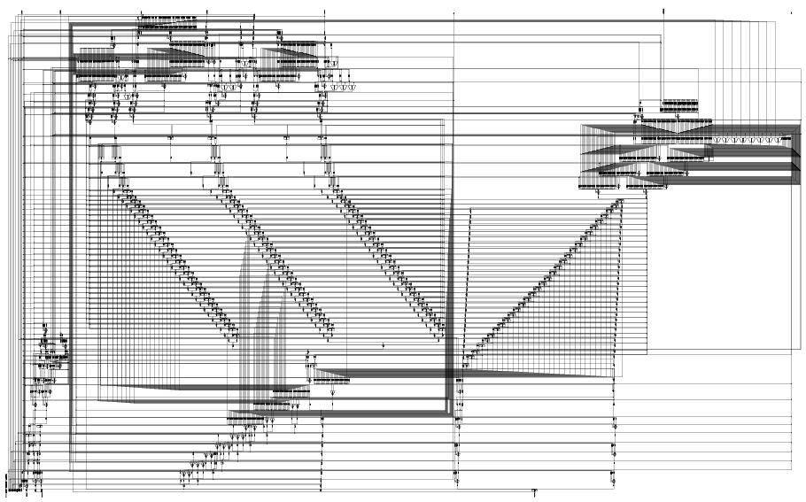
Synthesis – Change Dispensing

Slide 22
Final Words and Questions

